Slide 1
The Ag Law Education Initiative: Bridging The Gap Between Farmers and The Law
Paul Goeringer
Extension Legal Specialist
Ashley Newhall
Legal Specialist
AGNR Convocation
May 5, 2015

Slide 2
Agriculture Law Education Initiative
The Agriculture Law Education Initiative is a collaboration between the University of Maryland Francis King Carey School of Law and College of Agriculture & Natural Resources, University of Maryland, College Park. Through the University of Maryland Extension - the statewide, non-formal agriculture education system - the collaboration partners with the School of Agricultural and Natural Sciences, University of Maryland Eastern Shore.
Website: www.umaglaw.org
Twitter: @MdAgLaw
Facebook: www.facebook.com/MdAgLaw
Email: umaglaw@umd.edu

Slide 3
University of Maryland MPower
The University of Maryland: MPowering the State brings together two universities of distinction to form a new collaborative partnership. Harnessing the resources of each, the University of Maryland, College Park and the University of Maryland, Baltimore will focus the collective expertise on critical statewide issues of public health, biomedical informatics, and bioengineering. This collaboration will drive an even greater impact on the state, its economy, the job market, and the next generation of innovators. The joint initiatives will have a profound effect on productivity, the economy, and the very fabric of higher education.
http://www.mpowermaryland.com

Slide 4
Background Info
In 2011, the Maryland General Assembly directed the University System of Maryland “to leverage State resources to assist farmers in the State with estates and trusts issues, compliance with environmental laws, and other matters necessary to preserve family farms.”
Three institutions formed the Agriculture Law Education Initiative (ALEI) to address the legal educational needs of Maryland farm families.

Slide 5
Background Info
The ALEI started out by conducting some interviews of ag leaders in the state
MDA, MDE, and DNR officials,
Commodity groups,
And others
Also conducted a survey of UME ag educators, specialists, and nutrient management specialists.
Point was to determine the important legal issues faced in the state

Slide 6
Structured Interviews
Notes:
During April and May of 2013 in-depth, one-on-one structured interviews were conducted with 23 leaders from a wide range of statewide agriculture-related non-profit and government organizations.
The purpose of these interviews was to develop a broad-brush understand of the current legal challenges facing Maryland’s farmers.
Interviewees identified environmental, land use, nuisance/right-to-farm, and MDA programs as the biggest legal challenges impacting Maryland farmers.

Slide 7
Extension Survey
Notes:
In the summer of 2013, UME faculty were surveyed on what they perceived were the most important legal needs for the agricultural sector and how often they received questions on those issues.
They identified environmental regulations, USDA/MD Department of Agriculture programs, and land use issues as the most important legal issues.
These same issues were the ones that received the most phone calls

Slide 8
Who is ALEI?

Slide 9
Paul’s Background
Been doing legal risk management outreach since 2008:
Started at the National Agricultural Law Center at the University of Arkansas in Fayetteville as a research associate
2010 moved to Agricultural Econ & Agribusiness Department at the University of Arkansas
Handled development of written publications on legal issues facing Arkansas farmers
Handled risk management issues facing returning vets starting ag businesses
Worked on legal issues facing Native American producers
Since July of 2012, been working for the Agricultural and Resource Econ Department at UMD.

Slide 10
Ashley’s Background
Grew up on dairy in Arizona
Education:
BS from Arizona State
JD from Texas Tech
LLM in Ag and Food Law from University of Arkansas
Joined in May, 2014
Areas specializing in:
water (quality and quantity),
farm protection laws,
property law,
general agriculture issues

Slide 11
Sarah’s Background
Grew up in Delaware
Education:
BA from Washington College
JD from Pace School of Law

Slide 12
Sarah’s Background
In private practice since 2005 in Maryland
Past few years in practice in Easton MD.
Legal Specialist with Carey School of Law, joined in Dec. 2014.
Areas of expertise:
land use,
estate planning,
land preservation,
general agriculture law

Slide 13
Wele’s Background
Legal specialist with UMES, joined ALEI in 2014.
Areas of expertise:
international agriculture law,
general agriculture law,
liability issues,
farmer’s rights (human rights law),
food safety

Slide 14
Outreach and Partnerships across Maryland
Notes:
Teresa here

Slide 15
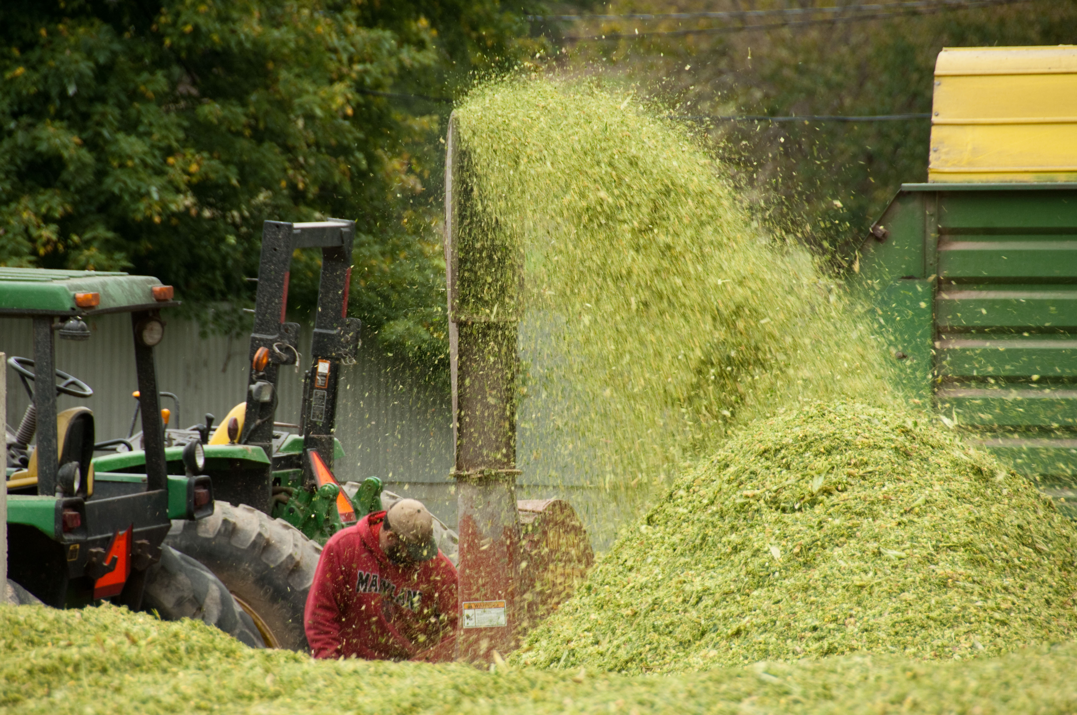
Highlights of Outreach across Maryland
Work with MDA’s ACReS Program and Maryland Farmlink to educate county realtor associations on agriculture and legal issues in the state
In 2015, we are working with Crop Insurance Education Program to sponsor 6 regional Estate Planning Workshops.
Notes:
This year will sponsor 2 poultry workshops next week on Eastern Shore and hope to sponsor more events.

Slide 16
Highlights of Outreach across Maryland
Maryland Dairy Convention, Frederick County, February 2015
Paul and Ashley presented “Mistakes That Impede A Farm Transition to the Next Generation”
Precision Ag Day, August 2015
Paul will be presenting on Drone laws
Ashley will be presenting on Big Data laws
Notes:
This year will sponsor 2 poultry workshops next week on Eastern Shore and hope to sponsor more events.

Slide 17
Partnerships
MidAtlantic Women In Agriculture
ALEI members participated, and continue, to do Webinars in partnership with WIA
ALEI members did presentations for the Preconference at the WIA Annual Regional Meeting in DE
Participated in Supper Seminar Series in Harford County

Slide 18
Partnerships
Estate Planning Workshops with Crop Insurance
Fall 2015-planning for 6 regional estate planning workshops
Ag Risk Management Blog (aglaw.umd.edu) in partnership with Crop Insurance Education Program
USDA Grant for Community Supported Agriculture Workshops in partnership with AREC, MDA, and MFB
2 workshops and 2 webinars discussing membership agreements and labor laws

Slide 19
Partnerships
Co-hosting series of webinars with Maryland State Bar Association’s Ag Law Section
Section members have requested programs to learning more about the agriculture industry
What would you be willing and able to teach?

Slide 20
Partnerships Outside of Maryland
Working to develop relationships with other ag law programs in the US:
Pennsylvania
We are working on putting together a workshop for both MD and PA farmers on employment law issues
Texas A&M
Partnering with Extension Ag Law Specialist to look into what laws are in existence that will protect farmers

Slide 21
Building capacity in the legal community
Notes:
Teresa here

Slide 22
Regional AALA Meeting
ALEI hosted AALA’s first ever regional meeting in June 2014 at UM Carey Law
Topics covered recent CAFO litigation, food safety developments, ag labor developments, and more
Notes:
Day long meeting hopes to bring in ag attorneys from across the Northeast and Mid-Atlantic
50 participants and response was it was a success.

Slide 23
Maryland State Bar Association
In Fall 2013, began working with lawyers to form first ever Agriculture Law Section of the Maryland State Bar Association
Section has developed a directory of member attorneys and their areas of practice related to agriculture.
Notes:
Currently has 100+ members.
One of our most often requested items was a lawyer with expertise, so we are working both on finding the lawyers and building the expertise.

Slide 24
Resources Available

Slide 25
Infoline
Call in service to direct you towards legal resources. The entire team all help with it.
We can’t provide legal advice, but if you need legal help we can direct you towards attorneys in your area.

Slide 26
Website umaglaw.org

Slide 27
Publications Available
Estate Planning
Leasing,
Livestock Liability
Fencing Liability
Legal Directory
Right to Farm overview
Ag Labor
Business Organizations
Right of Entry (or What to do when the “Man” knocks on your door);

Slide 28
Publications Under Review:
Legal issues with UAVs (drones);
Migrant Seasonal Workers
Premise Liability
Risk Management Strategies
Big Data Legal Issues
Water Law Appropriation in Maryland

Slide 29
Risk Management Education Blog
aglaw.umd.edu

Slide 30
Training on Resources
We have a number of resources available and is growing.
Plan to hold series of in—person workshops and/or webinars to educate ag service professionals on what is available.

Slide 31
Additional Issues
Not see an issue up on the list?
Contact one of us and let us know what it is.
anewhall@umd.edu
lgoering@umd.edu

Slide 32
Thank You
Ashley Newhall
Phone: 301-405-3541
Twitter: @MDAgLaw
Email: anewhall@umd.edu
Paul Goeringer
Phone: 301-405-3541
Twitter: @AgLawPaul
Email: lgoering@umd.edu
List of publications: www.aglaw.umd.edu/paul-goeringer

